Slide 1
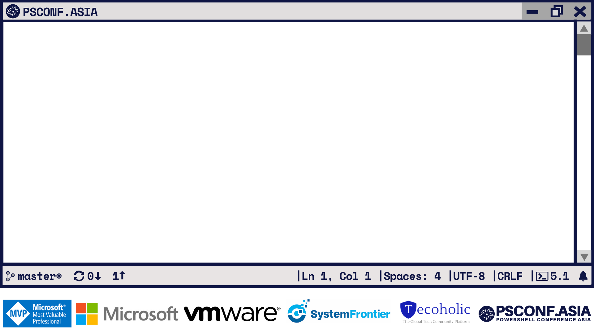
Creating Maps with Universal Dashboard
Adam Driscoll
Head Nerd, Ironman Software

Slide 2
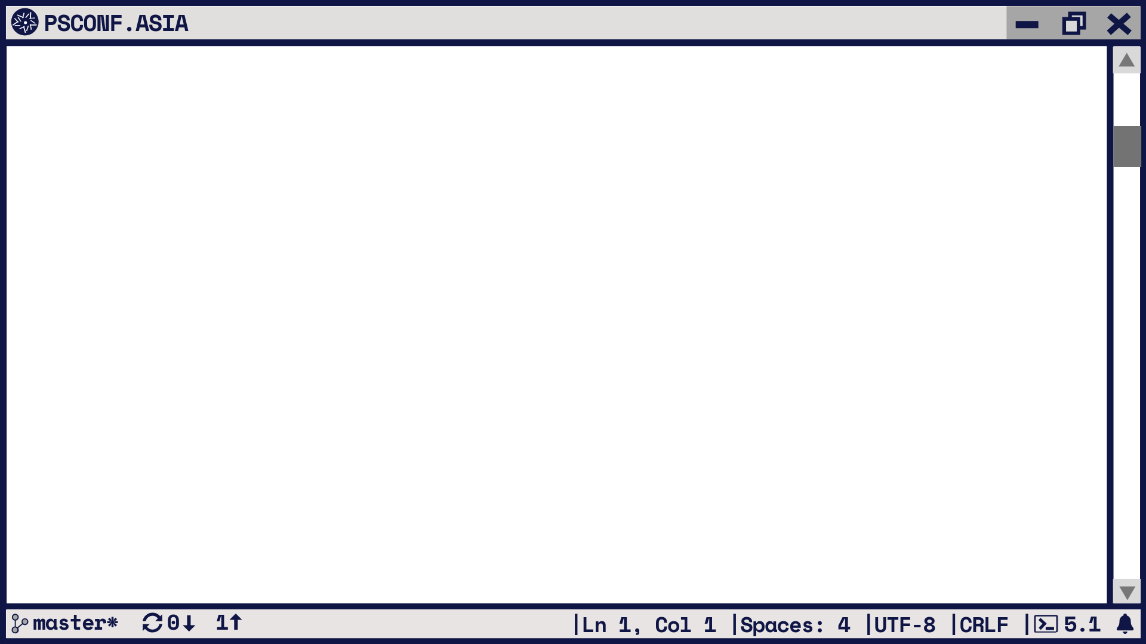
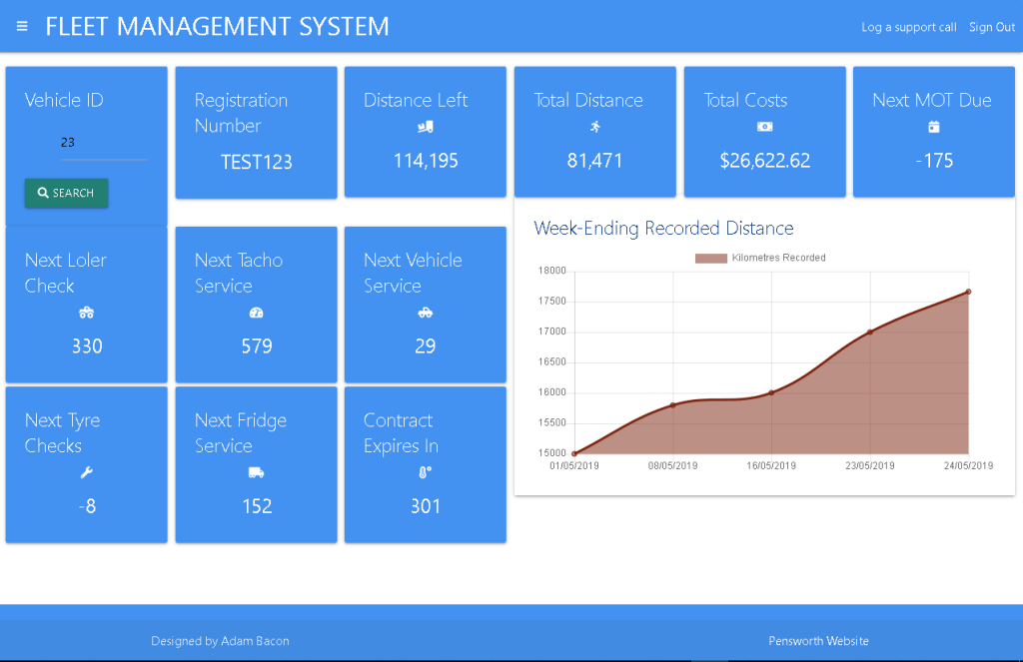
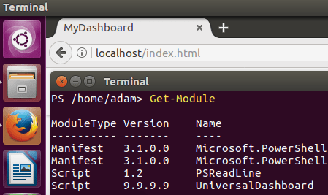
PS > What is Universal Dashboard?
Web framework for PowerShell
Cross-platform PowerShell Module

Slide 3
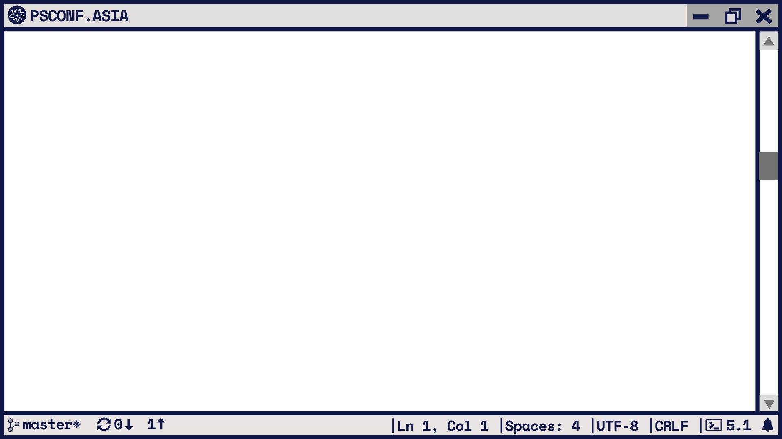
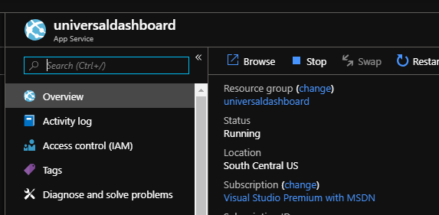
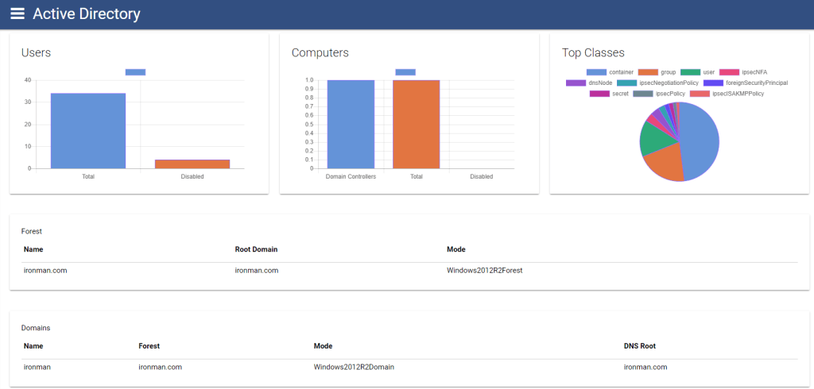
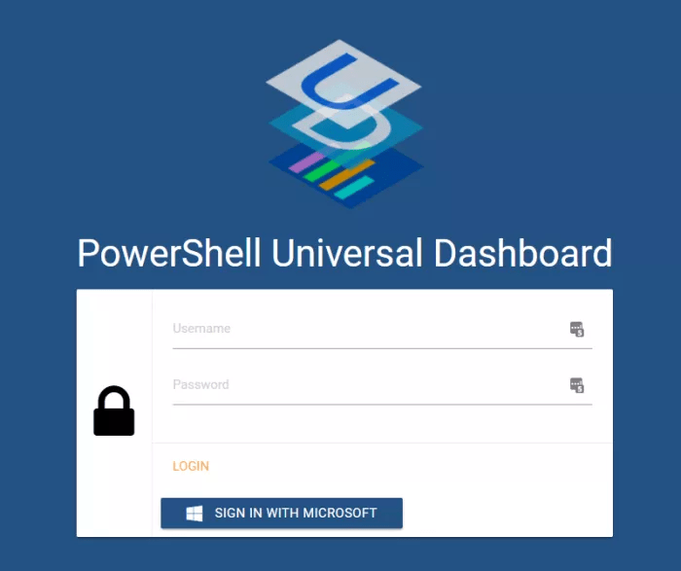
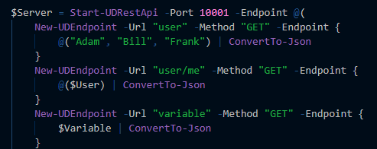
PS > What is included with Universal Dashboard?
Built-in Web Server
Dozens of Controls
REST API Support
Authentication and Authorization

Slide 4
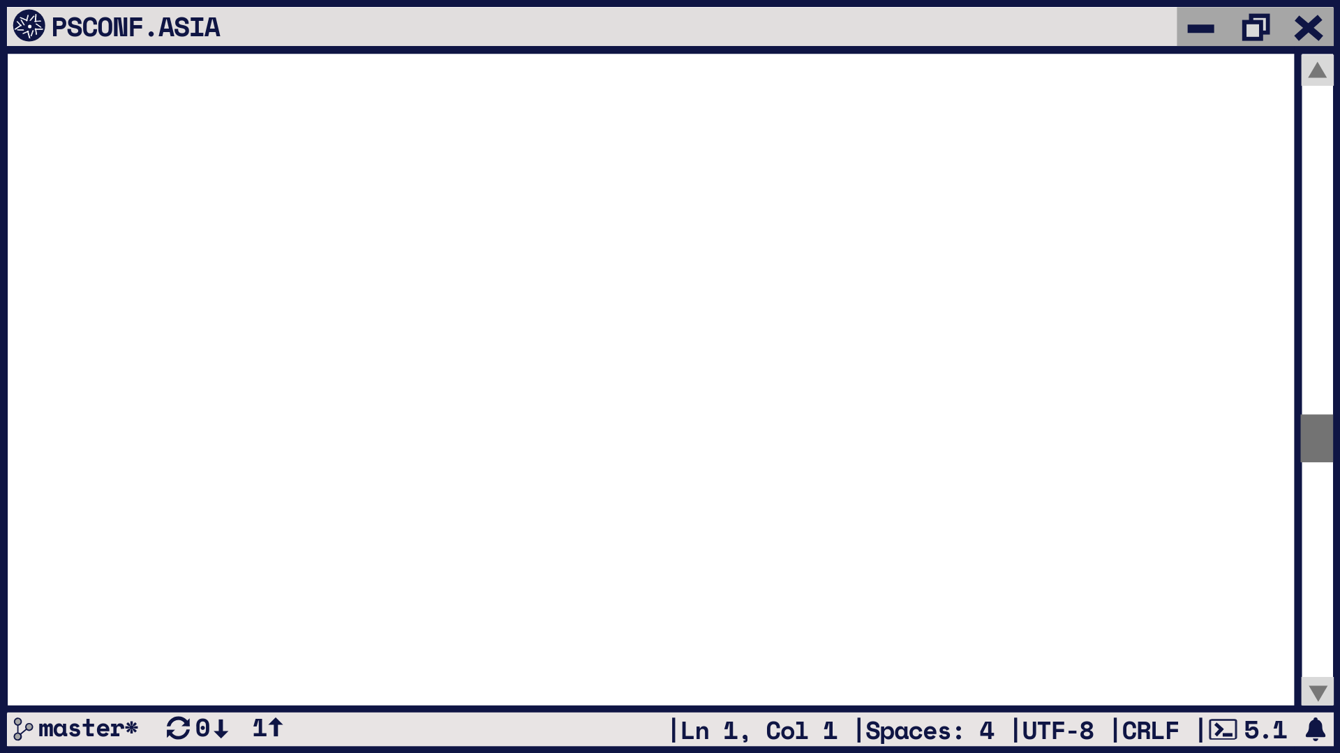




PS > What makes Universal Dashboard different?
+
=
*

Slide 5
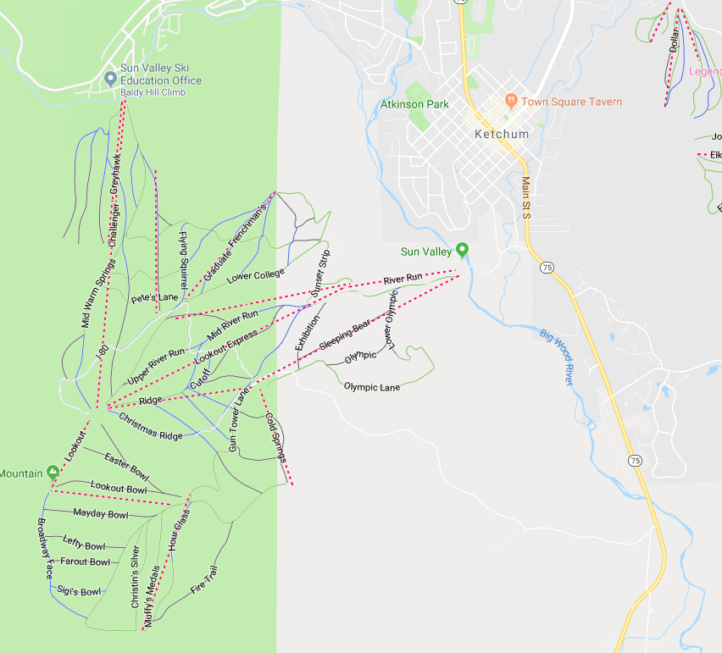
PS > Mapping Lingo
Marker
Vector Layer
Base Layer

Slide 6
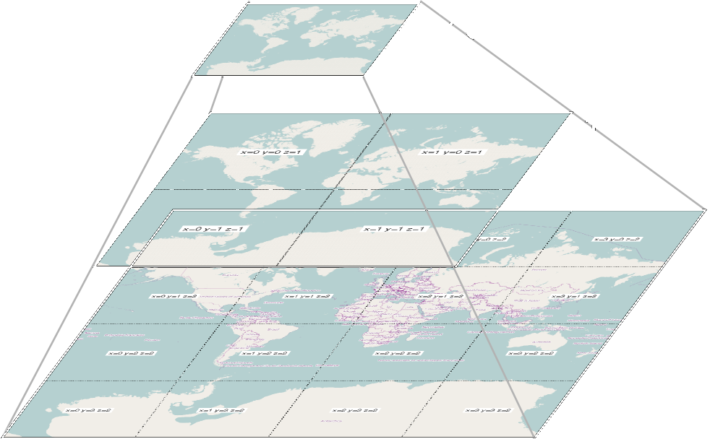
PS > Tile Concepts
https://a.tile.openstreetmap.org/${z}/${x}/${y}.png

Slide 7
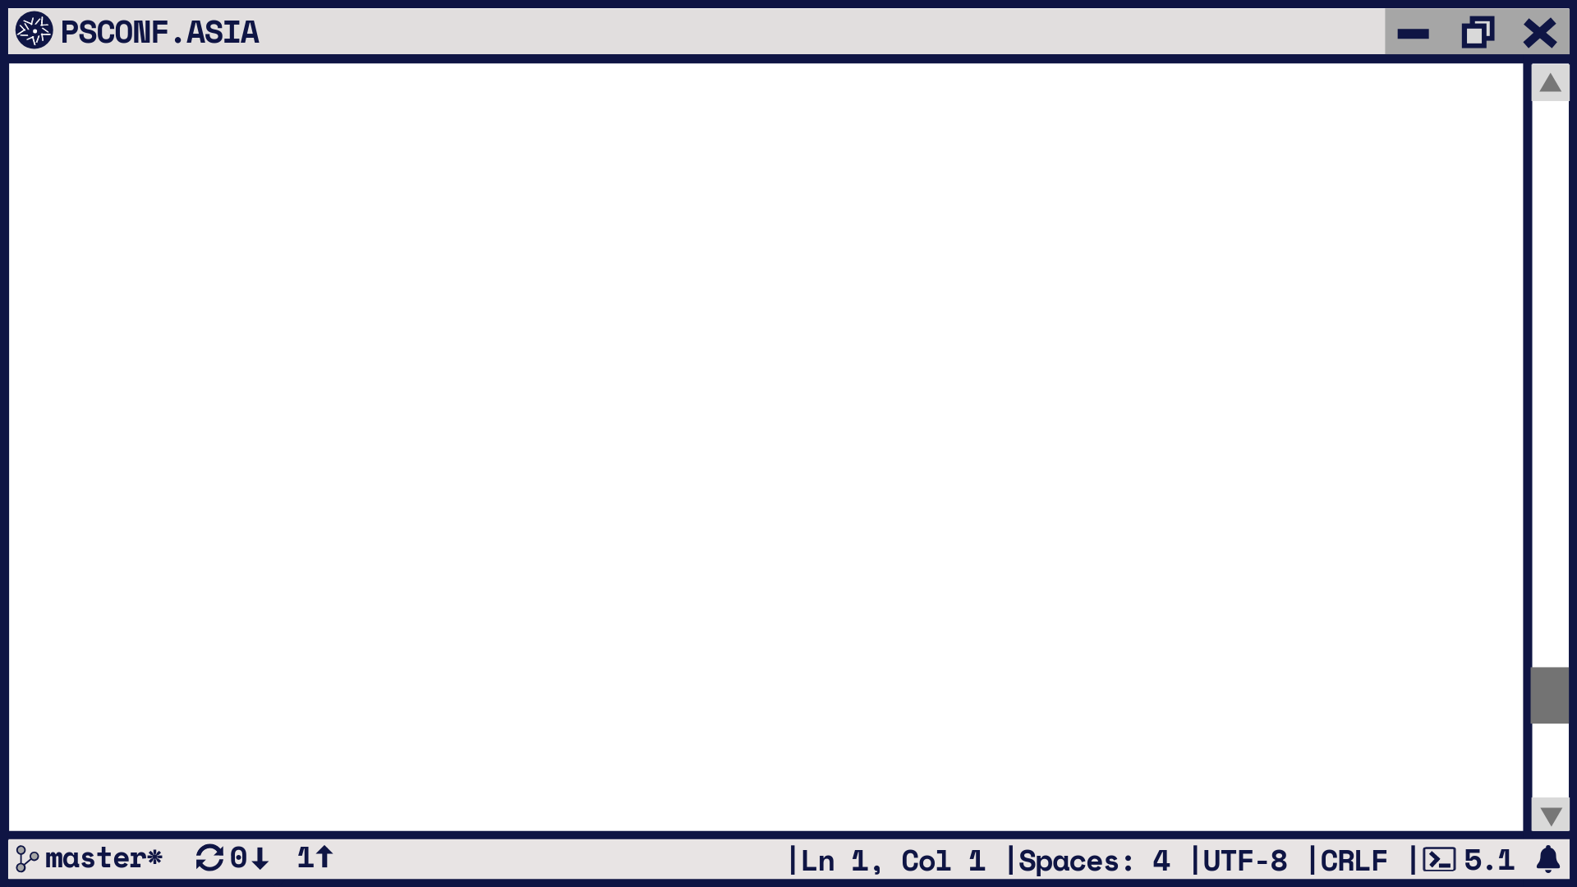
PS > .\Demo.ps1
.\demo.ps1 : The term '.\demo.ps1' is not recognized as the name of a cmdlet, function, script file, or operable
program. Check the spelling of the name, or if a path was included, verify that the path is correct and try again.
At line:1 char:1
+ .\demo.ps1
+ ~~~~~~~~~~
+ CategoryInfo : ObjectNotFound: (.\demo.ps1:String) [], CommandNotFoundException
+ FullyQualifiedErrorId : CommandNotFoundException

Slide 8
PS > .\ContactMe.ps1
Twitter - @adamdriscoll
GitHub – ironmansoftware or adamdriscoll
Forums – https://forums.universaldashboard.io
Marketplace – https://marketplace.universaldashboard.io

Slide 9
